Slide 1

Personal Finance
Chapter 1

Slide 2
Objectives
What is Personal Finance
What are The Elements of Personal Finance
What is Financial Literacy
Wants vs Needs

Slide 3
What is Personal Finance
Personal finance: everything in your life that involves money
Personal Financial Planning: refers to the process where an individual, or a family unit, arranges their money for spending, savings, and investing over time in order to live comfortably

Slide 4
5 Elements of Personal finance
Income - refers to a source of cash inflow that an individual receives and then uses to support themselves and their family
Spending - expenses an individual incurs related to buying goods and services or anything that is consumable with cash, credit, check or loan
Savings - excess cash that is retained for future investing or spending
Investing - the purchase of assets that are expected to generate a rate of return, with the hope that over time the individual will receive back more money than they originally invested
Protection - products you can purchase that can be used to guard against an unforeseen/adverse event such as loss of money or property

Slide 5
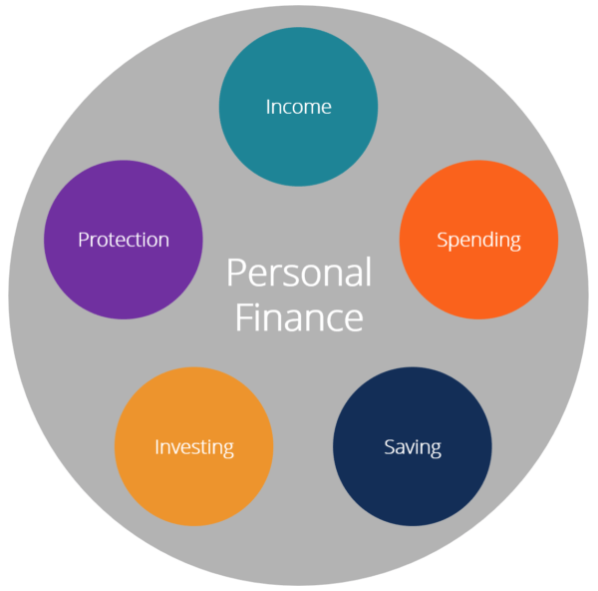
Elements of Personal finance
  Each element has of variety of options for you to use to meet your financial goals. Options can include but are not limited to:
    Budgeting, Banking, Spending, Insurance, Mortgages, Saving for your child's college education, Investments, Retirement planning, Tax and estate planning,

Slide 6

Group Activity: Elements of Personal Finance
- At each Table: Groups of 4 or 5
- In the boxes, enter the 5 elements of PF
- Below the boxes, place the pieces you receive under the correct category
5 Elements of PF

Slide 7
Financial Literacy
Financial Literacy: is the ability to understand and APPLY the elements of personal finance effectively (AKA money management)
Effective money management (What will this do for you)?
  helps individuals become self-sufficient
  gives you control of your money and your life
  allows YOU to decide where your money goes
  enables you to get what you NEED to survive, and allows you to achieve what your WANT

Slide 8
  Financial Planning:
Financial planning begins with which of the five elements?
  Income
Without income, there is nothing to spend, nothing to
invest, nothing to save, and nothing to protect
Your income level, and how much you earn enables
you to purchase what you need, and plan for what you
want.

Slide 9
Wants and Needs
In order to make decisions to effectively manage your income, you must first understand wants and needs:
Needs – a basic necessity. Something you must have, can’t live without, or need to survive
  Examples: groceries, water, shelter, clothing
Wants – something you desire but can live without
  Eating out, new Tesla, an xbox, a new phone

Slide 10


Slide 11
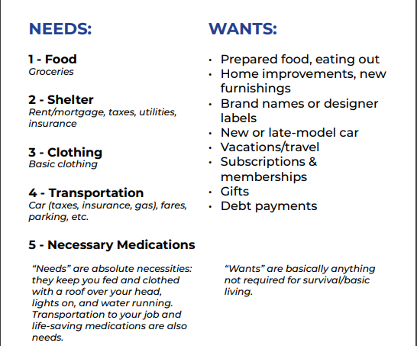
Wants versus Needs

Slide 12
Wants versus needs
What SHOULD be purchased/acquired first, a want or a need?
  A need must be taken care of first. Why?
  Does taking care of our needs first always happen?

Slide 13
Assignment
Go to Google Classroom
Complete the Google Assignment – Wants and Needs

Slide 14
Biggest Money Mistakes
Video
Mistakes as we age:
  Avoiding Risky Investments when young – 20s
  Spending too much and not investing – too big a house – 30s
  Spending money to support their kids and parents
  Borrow or pull money from your retirement fund – 40s
  Make Risky investments to try to catch up – 50s
  In 60s making poor decisions due to
    Video states don’t pull this out until your 72

Slide 15
Assignment
Complete the bottom of page 3 of your Note Activity Packet. Read the article provided by your instructor and find another for additional ideas.
Complete the Google Classroom Questions after reading

Slide 16
Assignment
Complete the bottom of page 3 of your Note Activity Packet. Read the article provided by your instructor and find another for additional ideas.
Complete the Google Classroom Questions after reading

Slide 17
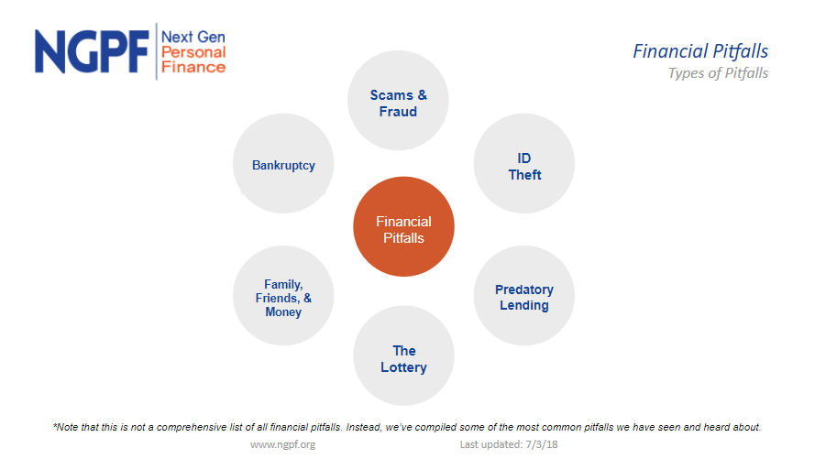

Slide 18
Opportunity Costs
Opportunity costs: what you give up to get something else
If, for example, you have a choice of going to a movie with friends ($20.00) or reading the book from the library. You choose to go to the movie. What is your opportunity cost?
  Gave up $20.00 going to the movie
  Your decision is based on what (want or a need)
If you read the book instead of going to the movie, what do you give up?
  Time with friends
  you missed a great movie with the theater experience
Does an opportunity cost always have to be about the money you save/earn?

Slide 19
Opportunity Cost Example:
You decide to go to college directly from high school and do not work. Tuition and fees are the major cost of going to college. What is the opportunity costs you give up by going to college?
  Time doing other things, lost wages on full time employment, purchasing items you want
If you choose to go directly to work instead of college, what are the opportunity costs
  Give up the possibility of higher paying jobs/professional roles
  A Degree to prove your knowledge
  Getting started on college later in life (if I plan to go later)

Slide 20
Ticket out of Class
Google Classroom EdPuzzle on the Hidden Costs

Slide 21


